Slide 1
Employee Data Analysis using Excel
STUDENT NAME: NIVETHA.R
REGISTER NO: 122201929 asunm135122/cp/52
DEPARTMENT: B.Com( Corporate Secretaryship)
COLLEGE: CHEVALIER T. THOMAS ELIZABETH COLLEGE FOR WOMEN

Slide 2
PROJECT TITLE
Employee Marital Status Analysis using Excel

Slide 3


AGENDA
Problem Statement
Project Overview
End Users
Our Solution and Proposition
Dataset Description
Modelling Approach
Results and Discussion
Conclusion
3/21/2024 Annual Review

Slide 4

PROBLEM STATEMENT
To Develop an Excel based Employee marital status Scorecard to systematically evaluate and monitor employee marital Status across multiple criteria.
The scorecard should facilitate Track changes in marital status and relationship trends over time

Slide 5

PROJECT OVERVIEW
.
An employee marital status in a excel is a tool used to systematically evaluate and track the employees marital status according to certain objectives
. In typically Includes various categories such as Married,
Divorced, Single, Widow

Slide 6

WHO ARE THE END USERS?
HR PROFESSIONALS
MANAGER
SUPERVISORS
EXECUTIVE
EMPLOYEES

Slide 7

OUR SOLUTION AND ITS VALUE PROPOSITION
CONDITIONAL FORMATING – EDITING BLANKS MARK
FILTERING – REMOVING MISSING VALUES
USING PIVOT TABLE – SUMMARY OF EMPLOYEE PERFORMANCES
FORMULA - =IFS FORMULA
USING SLICER – EMPLOYEE TYPE
GRAPHS = FINAL REPORT

Slide 8
Dataset Description
Employee dataset – Kaggle
26 features
9 features used
EMP ID
First Name-text
Last Name-number
Start Date-number
Email ID
Marital - Number
DOB, Department
Employee type

Slide 9

THE "WOW" IN OUR SOLUTION
The dataset for the Performance Management Dashboard is designed to capture and analyze key aspects of employee marital status. It consists of multiple data fields that provide a comprehensive view of each employee’s marital metrics. Here's a detailed description of the dataset structure and the significance of each data field:
Dynamic Data Summarization
Interactive Data Exploration
Customizable Views and Reports
Trend Analysis and Comparison
Visual Data Representation
Efficient Data Management
Advanced Filtering and Grouping
3/21/2024 Annual Review
9

Slide 10
MODELLING
STEP 1 : DATASET FEATURE SELECTION – EMPLOYEE ID , FIRST NAME, LAST NAME , START DATE, EMPLOYEE EMAIL, DEPARTMENT ,GENDER, EMPLOYEE TYPE, MARITAL STATUS.
STEP 2 : DATA CLEANING : MARITAL CATEGORY COMPUTATION USING FORMULA : =IFS(Single, Married, Widow , Divorced )
STEP 3 : MARITAL STATUS SUMMARY PIVOT TABLE
10

Slide 11
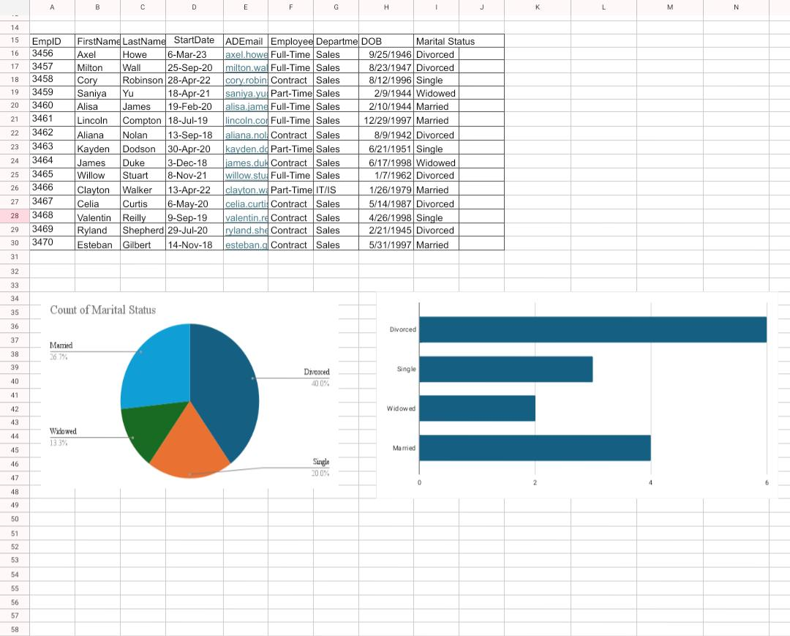
RESULTS
11

Slide 12
conclusion
"Analyzing marital status provides valuable insights into an individual's relationship dynamics, socioeconomic factors, and potential needs
Identify trends and patterns in relationship stability and dissolution.
Inform strategies for strengthening marriages and families.
Develop targeted interventions for at-risk couples.
Enhance customer segmentation and marketing efforts.
Support data-driven policy decisions.

